Slide 1
TAR UMT International Hackathon 2024
Team Name : perror(“520”);

Slide 2
TABLE OF CONTENTS
01
03
02
04
Topic
Product
Problem Statement & Solution
Demo

Slide 3

INTRODUCTION
Hi, our team is perror(“520”); and we’re students from TAR UMT Diploma in Computer Science Year 1 Semester 3. This is our first hackathon and we are excited to dive into the challenges and opportunities it presents.

Slide 4
TEAM MEMBERS
Yeoh Wei Jeng
Amber Lim Jia Yi
Koay Yuxien
Yeoh Jun

Slide 5
01
TOPIC

Slide 6
Data Leaking
Data leaking refers to the unauthorized transmission or disclosure of sensitive information from within an organization to an external destination or recipient.

Slide 7
02
PROBLEM STATEMENT
&
SOLUTION

Slide 8
Problem Statement
Real-time detection of data leaks across various digital platforms
Datas are often leaked and organizations might not realise it until it is too late. Therefore, creating a solution to detect data leaks in real time can help organizations track the data leakage more effectively and in shorter time. This will prevent loss for the organizations and keep the data stored save and secure.

Slide 9
Solution
Detect: Create ways to find data leaks in real-time or through regular checks.
Our system can detect all the activities in the system such as login activity, encryption, decryption and the file name that has been encrypted or decrypted. This will allow admin to check for any unusual activity.

Slide 10
Solution
Prevent: Come up with ways to stop data leaks using encryption, access controls, or data masking.
Our system prevent data leaks by using encryption to encrypt the file selected by users. Furthermore, only staff that entered the correct staff id and password can perform the encryption and decryption of file. At the same time, if wrong password is being entered, it will also be stored in the audit log.

Slide 11
03
PRODUCT

Slide 12
1 Staff ID and password
These are our default Staff ID and Password which are in our binary file. User can still add more staff.
Staff ID | Password
S0001 | eJ7%y9*Lv0!mZ^3r
S0002 | Qz8p$1a!2R#vS%7n
S0003 | G5h&n3*P0@w8L^qZ
S0004 | Y1!g$7n8@Q^dT5s0
S0005 | U*9b@c0^W3#y4K!8

Slide 13
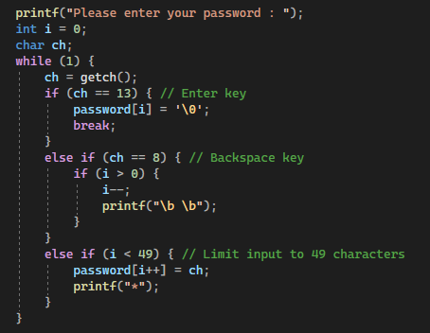
2 Hidden password
To prevent the password input by the user is not leak to others, we made the password to become asterisk (*) so that it can prevent others to see it.

Slide 14
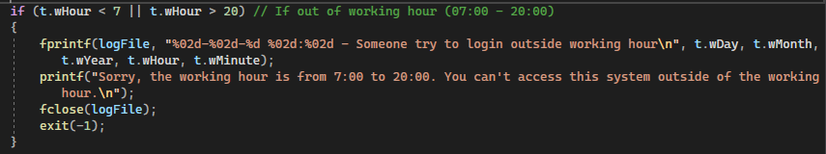
3 Give out warning to admin for suspicious activity
A warning message will send to a warning file if there’s suspicious activity. For example, someone try to login when it is outside of working hours, write a wrong ID or a wrong password. It will also leave a message if someone successfully login.

Slide 15
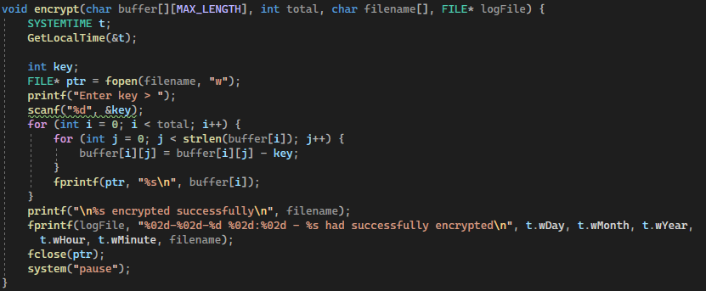
4 Encryption and Decryption
We’re using Caesar Cipher for our encryption and decryption.

Slide 16
04
DEMO

Slide 17
Sign in
Use the Staff ID and password to sign in

Slide 18
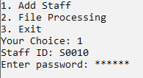
Add Staff
User can choose to register for new staff. The system will auto generate the ID.

Slide 19
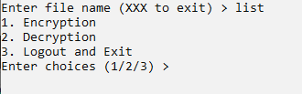
Open File
Type in the file name you would like to encrypt or decrypt, then choose an option.

Slide 20
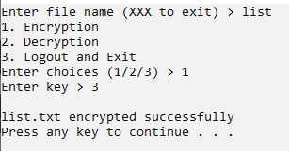
Encrypt Your File
Key in the key you would like to encrypt.

Slide 21
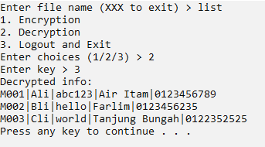
Decrypt Your File
Key in the correct key so that you can see the decrypted message.

Slide 22

Decrypt Your File
All of the sensitive activity made in this system will be stored into the auditlog.txt text file. You can check the audit log of the system by this file so that it is easier for us to detect any unusual activity.

Slide 23
THANKS!
Do you have any questions?
yeohwj-pm23@student.tarc.edu.my
+60 10 825 2731

